Slide 1



Gen AI Hackathon
- Scripterz -

Slide 2



Introduction
Problem Statement
Solution
Conclusion
Contents

Slide 3
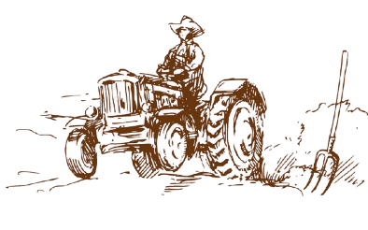

Introduction
Introduction
Problem
Agriculture is the backbone of our country- its economy, its culture and its way of life. Despite this, farmers face significant challenges in accessing information like- market prices, insurance policies, cropping trends that could directly impact their livelihood.
Limited connectivity, language barriers and mobility issues contribute to farmers not receiving real time updates on market prices. Therefore, they often sell their crops at unfavourable prices and face losses.
Statement
Solution

Slide 4
Introduction
Problem Statement
Problem
Small-scale farmers in remote regions face significant challenges in accessing timely market price information. This lack of information often leads to suboptimal pricing for their produce, limited financial resilience against crop failures, and an inability to make informed decisions about risk management.
Statement
Solution
There is a need for a solution that leverages generative AI to provide real-time, localized market price updates, enabling farmers to make better financial decisions and enhance their livelihoods.

Slide 5


Introduction
Solution
Problem
Provide real time market prices
We aim to collect and analyse data from markets, government and local sources.
Predict trends using AI for better crop selling decisions.
Statement
Solution
Accessible Interface
Easy to use mobile app or website with support for voice response and offline usage.
Will also include a chatbot to support interactive Q&A.

Slide 6
Conclusion
Farmers constitute 47 to 58 percent of the Indian population and agriculture contributes to around 20% of India’s GDP. Yet they face several challenges in accessing the aid needed to actually optimize their living in terms of loss management and income.
Problem
Statement
By harnessing the recent developments of AI, we aim to bridge the information gap by providing real time, localized market price updates and insurance guidance in a friendly and understandable way.
Solution
The proposed platform can change the agricultural landscape by increasing economic resilience, improving livelihoods and promoting sustainable development in rural areas.

Slide 7
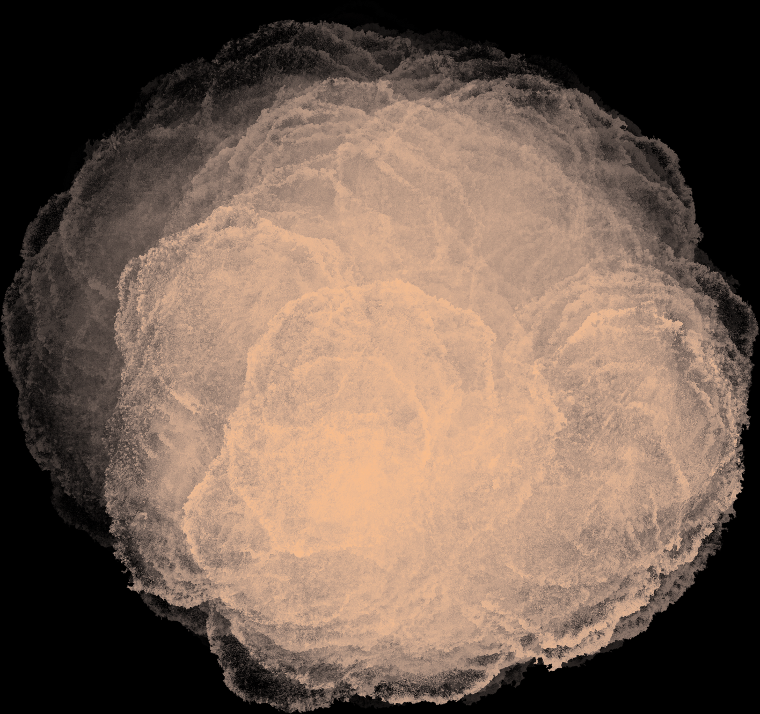
Thank
you

